Slide 1
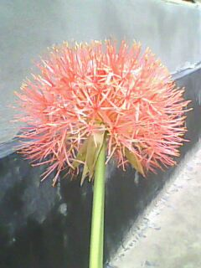

Welcome
Welcome to ICT Class

Slide 2
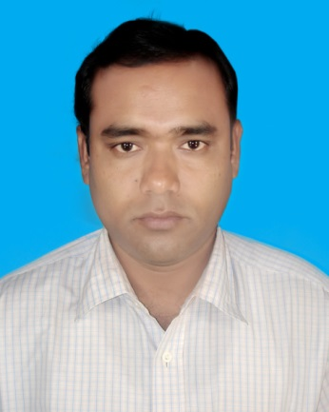
Teacher Identity
Dulal Chandra Mondal
B A, B,Ed
Assistant Teacher(Computer Studies)
Arji Naogaon High School
Naogaon Sadar, Naogaon.
Mobile : 01746738772
E-mail : dcmondal1977@yahoo.com

Slide 3

Learning out comes
At the end of the class Student’s will be able to learn ....
1. Definition of the computer.
2. Classification of computer.
3. Different part’s of computer.
4. Computer Generation.
5. Classification of computer memory, Digital
Logic, Hardware , Software, Printer, Computer
Language, Number System ,
6. To Create a LAN Network.

Slide 4

Definition of computer
A computer is an electronic machine , operating under the control of instructions stored in its own memory, that can accept data, process the data according to specified rules, produce results and store the results For future use.

Slide 5
Computer
Classification of Computer
Analog Computer
Hybrid Computer
Digital Computer
Classification of Digital Computer
Mini Computer
Micro Computer
Super
Computer
Main
frame

Slide 6
Computer
Input
Output
CPU
Input Device
Mouse
Key
board
OMR
OCR
CD

Slide 7
Central Processing Unit(CPU)
CPU
Control Unit
Memory
ALU

Slide 8
Out Put Device
Speaker
Monitor
Printer
Impact
Non
impact

Slide 9
Computer Generation
First
1946-58
Fifth
Future
Second
1959-64
Fourth
1971-Prese.
Third
1965-70

Slide 10
Computer Memory
Memory
Main Memory
Auxi
Memory
RAM
Cash
Memory
CD
Floppy Disk
ROM
Hard Disk

Slide 11
Computer Hardware
Hardware
Monitor
Printer
Keyboard
Mouse
Mother Board

Slide 12
Digital Logic
Basic Digital Logic
Universal Gate
OR
NOR
NAND
AND
NOT

Slide 13
ইনপুট ইউনিট ও আউটপুট ইউনিট
ইনপুট ইউনিট :
যে যন্ত্র বা যন্ত্রাংশের মাধ্যমে কোন তথ্য বা নির্দেশ কম্পিউটারে প্রদান টরা হয় তাকে
ইনপুট ডিভাইস বা ইউনিট বলে।
আউটপুট ইউনিট :
যে যন্ত্র বা যন্ত্রাংশের মাধ্যমে কম্পিউটারে ইনপুটকৃত তথ্য ফলাফল আকারে পাওয়া
যায় তাকে আউটপুট ডিভাইস বা ইউনিট বলে।

Slide 14
Software
Software
System Software
Application
Software
Windows 7
MS-Word
Skype
Windows Xp

Slide 15
Computer Language
Computer Language
High Level
Language
Low Level
Language

Slide 16
Number System
Number System
Hexa Decimal
Binary
Decimal
Octal

Slide 17
Network
Network
MAN
LAN
WAN

Slide 18
How to Create a LAN Network
What is Local Area Connection:
LAN (Local Area Network) card will automatically install when you setup windows 7. LAN
connection is required when you want to share your pc with others in your Home Group.
Supposes you have two Laptop/Pc and you want to connect them for some purpose say playing
multiplayer games (Cod 1,Cod 2,Cod4,Cod5 etc) or to access another Pc ,just setup Local Area
Connection. You can also connect your Pc to your friends Pc no meter how far the distance
,connect them with cable connection.
Procedure of setup Local Area Connection:
• Crete Work Group:
1. Go to my computer properties.
2. Click change settings.
3. See
4. Type your Computer name and Work Group
5. This message will appear
6. Restart your computer then your Work Group will be created.
• Give your IP Address:
Continue........

Slide 19
How to Create a LAN Network
1. Go to control panel
2. Click Network And Internet
3. Click Network And Sharing Center
4. Click Home Group
5. Click Advance Sharing Setting
6. There are two types: Home to work, Public
7. From Home to work select >Turn on Network Discovery >Turn on file and printer
sharing >Turn on public folder sharing..... >Enable file sharing for device........ >Allow
windows to manage.....
8. From Public select >Turn on Network Discovery >Turn on file and printer sharing >Turn
on public folder sharing..... >Enable file sharing for device........ >Turn off password
protected sharing.
9. Click change Adapter Setting (Top left side of the window)
10. You will find this
11. Plug your cable and then find this
12. Now setup your IP. Right click on Local Area Connection go to properties.
13. Double click Internet protocol version 4 (TCP/IPv4) Or click properties
14. Click Use the following IP address
15. IP address:Give your IP address
16. Subnet mask: Just press tab it will automatically generate (Default-255.255.255.0)
17. Click use the following DNS server address.
18. Click ok.
Finally all setting comes to an end. Now you can easily connect or disconnect your Local Area
Connection. Remember follow the same procedure otherwise you will repeat a circular loop and
can't move forward. Just follow this procedure i think you can setup Local Area Connection
within a minute.

Slide 20
কম্পিউটার নেট
কম্পিউটারে ইন্টারনেট ব্যবহারের জন্য নিম্নলিখিত জিনিসগুলোর প্রয়োজন হয় -
১. কম্পিউটর ২. মডেম
৩. টেলিফোন লাইন ৪. প্রিন্টার
৫. ইন্টারনেট সংযোগ ৬. সফ্টওয়্যার

Slide 21
কম্পিউটার পোর্ট
কম্পিউটারের বিভিন্ন ধরনের পোর্ট-
১. সিরিয়াল পোর্ট ২. প্যারালাল পোর্ট ৩. স্ক্যাজি পোর্ট ৪. মনিটর পোর্ট
৫. কী-বোর্ড পোর্ট ৬. মাউস পোর্ট ৮. নেটওয়ার্কিং পোর্ট ৯. অডিও পোর্ট
১০. ইউএসবি পোর্ট ১১. গেম পোর্ট

Slide 22
ধন্যবাদ

